Slide 1
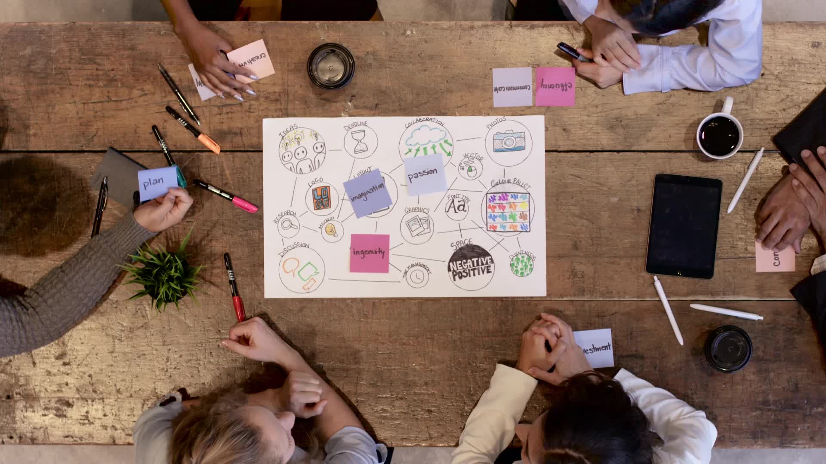
Final Project: Agile Presentation
By
Robert Thurber

Slide 2

Roles of the Agile Team: Project Manager
Project manager:
The project manage is responsible for communicating with the stakeholders and the end user to make sure everyone knows what the scope of the project is.
They are in charge of the backlog and ordering the work to be done from the backlog
Working with the scrum master to make sure that the backlog work is being done
Work on the product vision
Managing the project
Notes:
The project managers role in a successful scrum team is that they bring the customers perspective to the development team, the handle all the ordering in the backlog, keep the stakeholder and end-user informed on what is going on in case things need to be shifted around, and make sure that the end product is sticking to the product vision. During the SNHU travel project our project manager did a successful job in changing gears when we wanted to stay competitive within the market and give the customers what they wanted which was more focused on wellness and metal heath. The project manager restructured the back log and made sure to remove the items that were no longer going to be worked on a replace them with the new items.

Slide 3

Roles of the Agile Team: Scrum Master
Scrum Master
The Scrum Masters job is to make sure that the team sticks to the scrum practices and rules
Work with the Project manager with prioritizing the backlog
Manage the scrum team
Remove any barriers that stand in the way of the scrum team
Set up all team meeting throughout the projects life
Notes:
The scrum master role in a successful scrum team is to lead the development team, work with the project manager to ensure the backlog is being worked on successfully, remove any barriers for the development team, and help manage the development team including conflict navigator. The best example I believe from the scrum master in the SNHU travel project was during the scrum meeting where it was their turn to share what they did and what they were doing and the scrum master talked about adding blinds for the development team so they didn’t have to deal with the sun anymore, and how they were going to spend their day fixing issues that the development team was having so they could work easier.

Slide 4
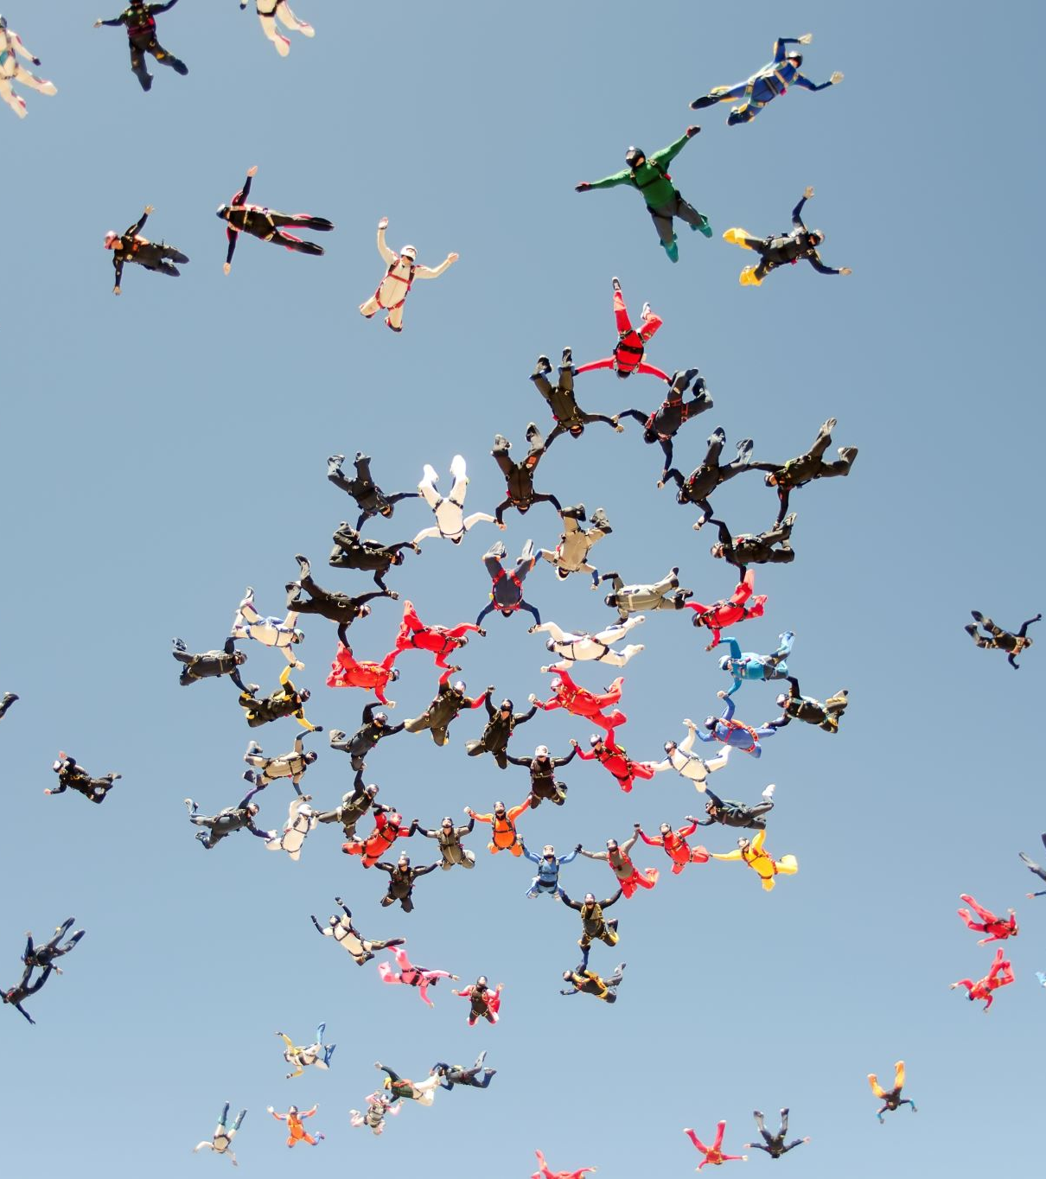
Roles of the Agile Team: Development Team
Development Team
The development team is to work on the project until the project hits the “done” phase of the project life cycle
Work together in a team manor with respect
There is no sub groups within the development team
The team is cross functional
The team has no title within it and everyone is on the same level
Notes:
The development team role in a successful scrum team is committed to achieving the goal of delivering the product on time and to requirements, no titles and or subgroups within the development team, everyone works together if a self-organizing way, and is cross-functional. From my personal experience I would use the company I work for now. We were both a GovTech and an EdTech company, but we are making the change over to focuses more on EdTech and our development team has made the switch to full integrating more features into the EdTech side while putting our GovTech software in maintenance mode.

Slide 5

Roles of the Agile Team: Tester
Tester
The Testers role is to create and design test that will make sure that the software is working in the way it is expected
Work with the project manager to understand fully what the software is expected to do and to understand its scope
Work with the development team so they no what is expected of them
The person that give the green light that the software working as expected
Notes:
The tester team role in a successful scrum team is to, build test that is within the scope of the project, communicate with the development team letting them know what the test is looking for, communicate with the product owner to keep them in scope of what they are really asking for, and to make sure that the software does what it promises to do. The best example of this is within the SNHU travel project where they switch from just a vacation spot to more of a wellness retreat and the scope of the project change. The tester would have to communicate to the development team letting them know what the new test are looking for and talk to the project manager to make sure that they have a good understanding of the new direct to not push the test out of scope.

Slide 6
Agile methodology Life cycle
The big take away with the agile method is that is is free flowing and can change at any time making it much more flexible than the waterfall method
Planning
This is where planning is done. In the agile methodology not a ton of planning is done, just enough to get by and just in time that it is needed
Design
This is where are the design work is done for the project. This can change at any time bases on the stakeholder and end user feed back
Develop
This is where the work get done. The development team takes the designs and makes them come to life.
Test
This is where the project get tested to make sure that it performs as expected
Deploy
This is where the project is deployed live for the stakeholders and end user to look at
Review
This is where the stakeholders decide if they like what they see or would like to make changes and or improvements. If they want changes / improvements then the cycle starts over again here after this stage
Launch
If the end users and the stakeholders are happy with what they see the project will go live here
Notes:
There are several different phases within the software development life cycle for the agile approach and they are plan, design, develop, test, deploy, review, and repeat until happy then launch. Within the planning phase just enough planning goes in to start the project the whole point of using the agile methodology, you don’t want to plan to much out or into much detail because we want the project to stay free flowing and flexible. The next step is design this is where the project is laid out to the way the stakeholder and end user would like. During the development stage this is where the work is actually being done and people are programing the actual software. Next is the testing phase this is where tests are written to make sure the program is actually doing what is supposed to do based on what the stakeholders and end users are looking for. Once all of the tests are complete and passed the next stage is review, this is where the product owner with sit with the stockholder and make sure that the software does what it is supposed to do, if not then we start the process over again at the design stage. If everyone is happy with the review stage, it will move over and be launch and the implementation will go live. There is one really important thing to remember with the agile method though and that is that during any one of these stages anything can change a switch gear to something new and you have to be ready for it.

Slide 7

Waterfall Method
Waterfall differences from agile
Waterfall is not nearly as flexible
Not adaptive
Once a part of the life cycle is complete its done and can not go back to that stage
Moves from one stage to the next with very clear goals
Good for project with clear define goals such as a housing development company that only offers three different styles of homes.
Notes:
The major difference between the waterfall method and the agile method is that the waterfall method is not nearly as flexible, and it moves from one stage to the next stage once the stage before it was complete and the is no going back to a stage once it has been complete. So, with the agile description above we will keep going through the stages until the stakeholders are happy and they have made the changes to get exactly what they want we will not do that with the waterfall method. There is a lot of time planning out exactly what is to be done then the work starts, if the stakeholders want something new or something to be change they will have to wait until the project is done then create a new scope for what they want.

Slide 8
Agile approach vs Waterfall approach
Agile approach
Tons of flexibility
Collaborate with stakeholders and end users
Good for short term deadlines
Waterfall approach
Concrete plans for the project
Have to provide deliverable to make it to the next stage
Requirements for the project are determined at the beginning
VS
Notes:
When it comes down to trying to decide what to use the waterfall method or the agile method you need to consider a couple of things. One of the most important things to consider is how flexible the project needs to be. If the project need to be flexible and being able to change on a notice then you would most likely want to be using the agile mythology so that you can change to the market and new stakeholder ideas. Let say on the other hand you are working for a housing development company then waterfall method might now be a bad choice because you are building the same house over and over again with not a lot of change besides maybe the three different versions. Another factor to consider when deciding on what method you would like to use is scope. If the scope cannot change whatsoever maybe do to resources a waterfall method might be better because you can at least finish the project and work out a new scope for changes that the stakeholders would like to see. If you have an extra resources or are willing to drop everything to change direction then the agile method would be much better.

